Slide 1
Preprints and Publication Ethics;
the Good, the Bad, and the Ugly
Fatemeh Heidary MD, MPH, PhD, FAAO, FICO
Clinician-Scientist
IVORC

Slide 2
Conflict of Interest
Founder and Editor in Chief of
Medical Hypothesis Discovery and Innovation in Ophthalmology
Medical Hypothesis, Discovery & Innovation in Optometry
The Eye Open Repository
Other potential COI:
www. drfatemeh.com
Figures from: https://unsplash.com/

Slide 3
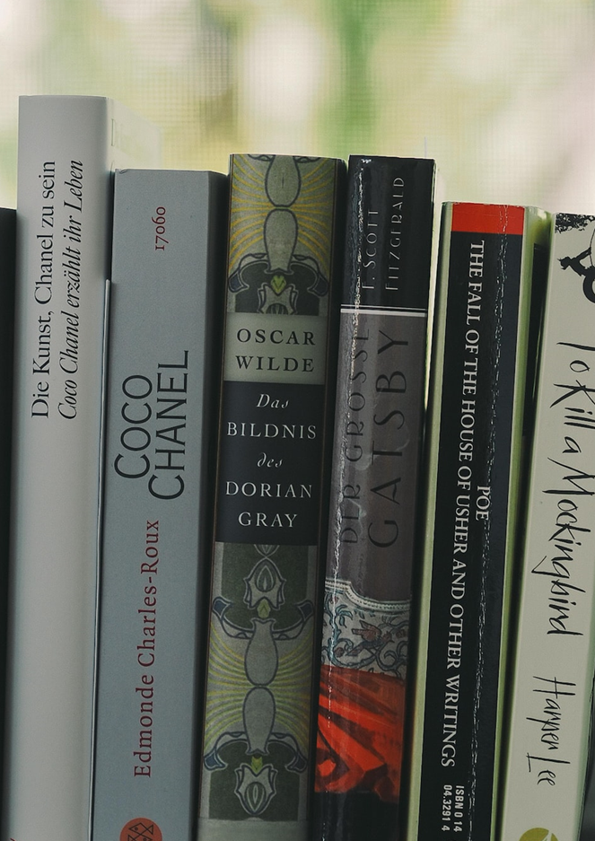
History of Preprint
A preprint is a full-draft research paper that is publicized prior to the formal peer review process.
The sharing of preprints goes back to at least the 1960s, when the National Institutes of Health circulated biological preprints.
In 2017, the Medical Research Council started supporting citations of preprints in grant and fellowship applications, and Wellcome Trust started accepting preprints in grant applications.
The first preprint study on COVID-19 was published on January 19, 2020, and thousands of articles were published subsequently.
Source: https://en.wikipedia.org/wiki/Preprint

Slide 4
List of preprint repositories
arXiv
Rutgers Optimality Archive
SSRN
Cryptology ePrint Archive
RePEc
CogPrints
HAL
PhilSci-Archive
E-LIS
Nature Precedings
hprints
ViXra
JMIR Preprints
Zenodo
F1000 Research
bioRxiv
Authorea
PeerJ PrePrints
Preprints.org
ChinaXiv
PsyArXiv
SocArXiv
engrXiv
OSF Preprints
INArxiv
ChemRxiv
EarthArXiv
LawArXiv
Wellcome Open Research
MarXiv
agriRxiv
Gates Open Research
SportRxiv
PaleorXiv
WikiJournal Preprints
Research Square
Preprints with The Lancet
Cell Sneak Peek
ESSOAr
Arabixiv
EcoEvoRxiv
LISSA
AAS Open Research
MindRxiv
MetaArXiv
AfricArXiv
ECSarXiv
HRB Open Research
Frenxiv
NutriXiv
FocUS Archive
medRxiv
EdArXiv
APSA Preprints
Beilstein Archives
Preprints.ru
IndiaRxiv
MediArXiv
BodoArXiv
AMRC Open Research
SciELO Preprints
TechRxiv
CrimRxiv
ARPHA Preprints
BioHackrXiv
Eyexiv
Jxiv

Slide 5
Is preprint good or bad? It’s actually both!
Although studies show that the average normal period for the peer reviewing process is 125 days, many of preprints published papers in less than a week.
What they do is an initial screening with a few editorial formalities, the details of which are available on preprint websites.
Although preprints as open publishing platforms provide early access to research outputs, the fact that the papers are not peer reviewed in formal processes has created deep controversies and concerns. Tables briefly lists the advantages and disadvantages of preprints.

Slide 6
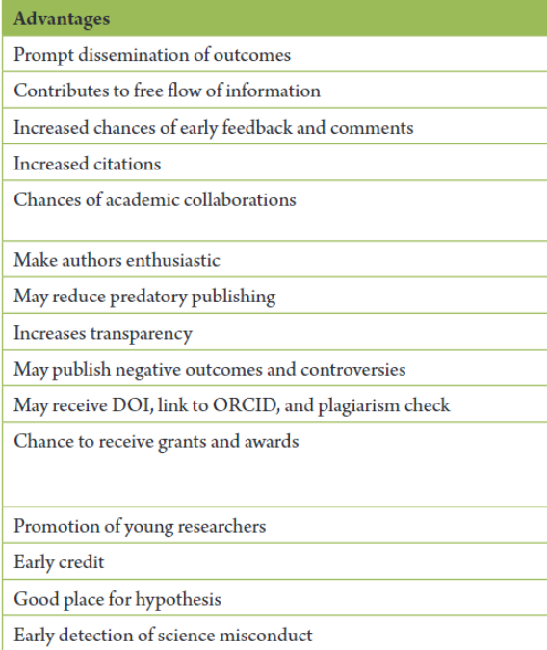
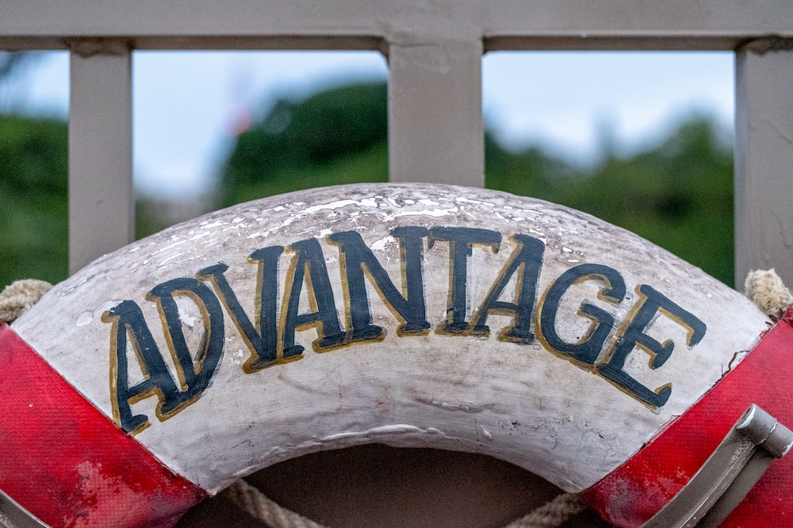
Source: Heidary F, Gharebaghi R , COVID-19 impact on research and publication ethics. Med Hypothesis Discov Innov Ophthalmol. 2021 Spring; 10(1): 1-4. https://doi.org/10.51329/mehdiophthal1414

Slide 7
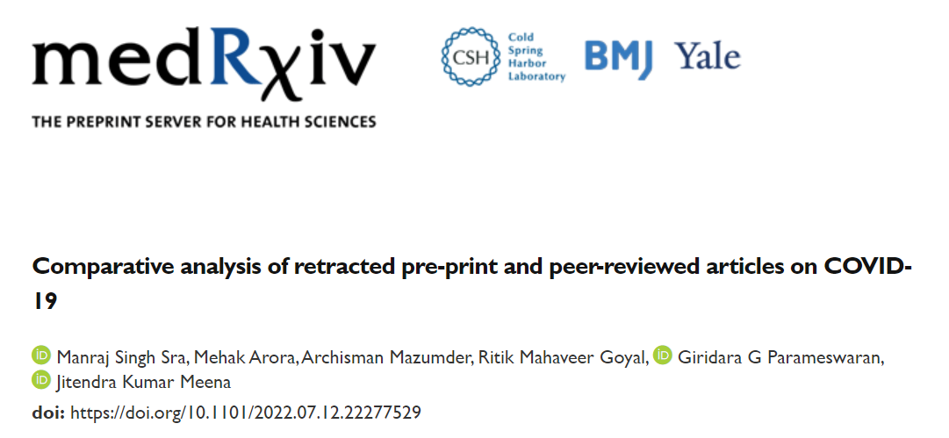
“Results: Authors identified 40 retracted pre-prints...
The increased adoption of pre-prints results in faster identification of erroneous articles compared to the traditional peer-review process.”

Slide 8
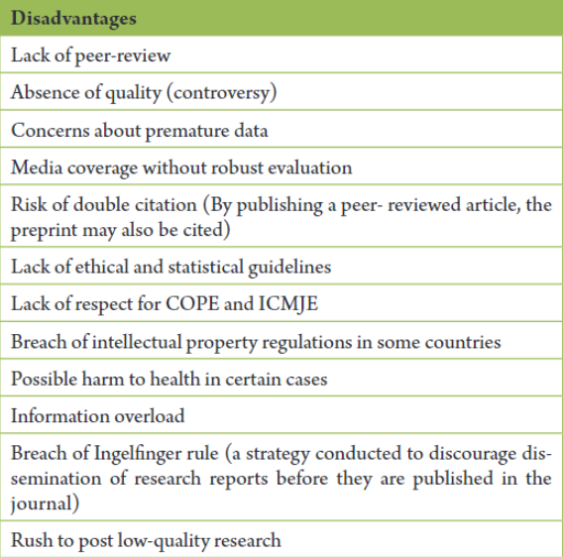
Source: Heidary F, Gharebaghi R , COVID-19 impact on research and publication ethics. Med Hypothesis Discov Innov Ophthalmol. 2021 Spring; 10(1): 1-4. https://doi.org/10.51329/mehdiophthal1414

Slide 9
The COVID-19 pandemic has highlighted the need for preprints.
Preprints are extending visibility in all fields.
Preprints as the pools to journals
Public review of preprints, through social media to assist the peer review process of the journals although it is not academically reliable.
New era in the specialized preprints (e.g. pulmonary preprint!)
Remove barriers on inequalities of indexing some preprints.
Remove conflict of interest between journal publishers and preprint owners.
Paid certified independent peer reviewers to check the validity of preprint content.

Slide 10
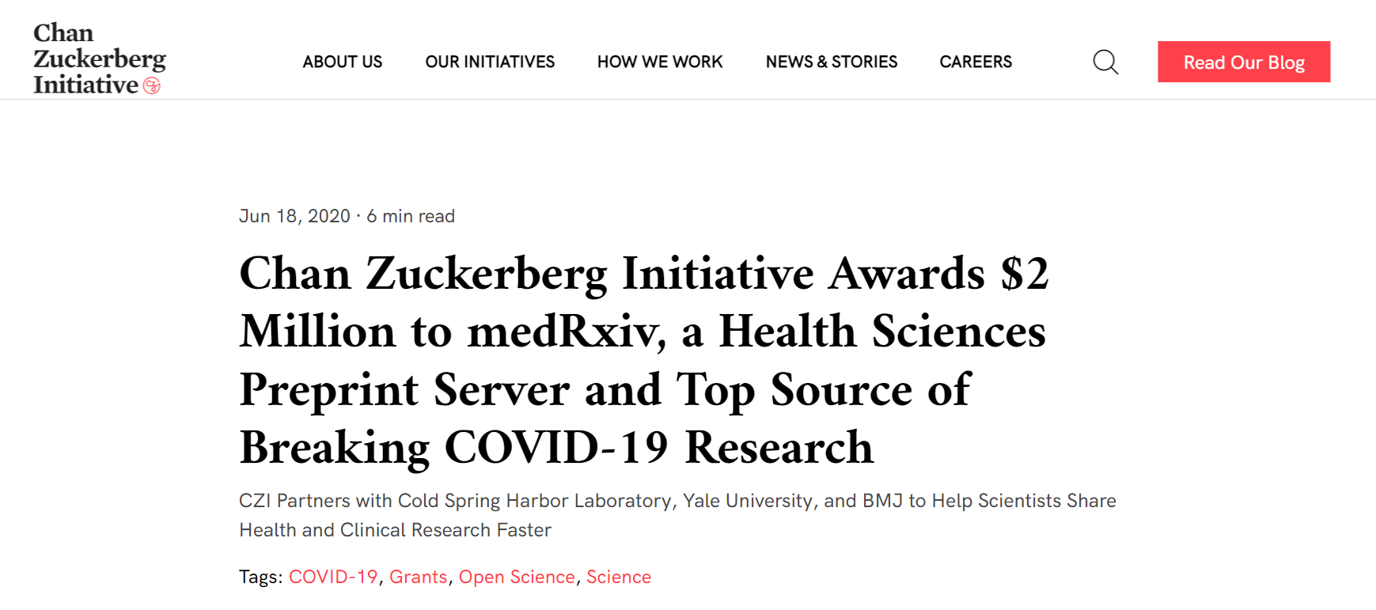

Slide 11
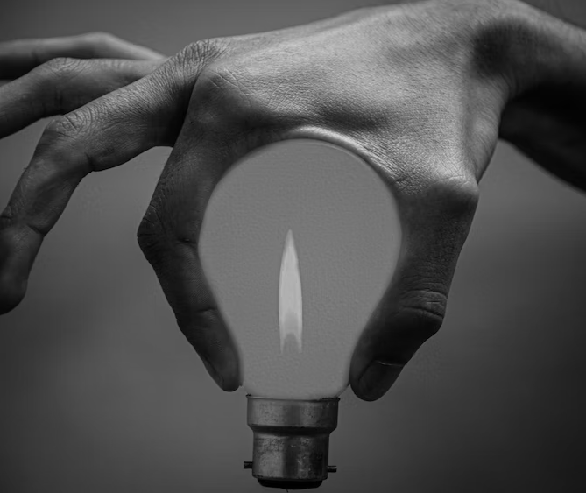
Automatic update of retracted papers to preprint servers
Academic credit (nationally) to researchers who deposit to preprints
Possible invasion of predatory journals to publish preprint papers without review
Necessity of adaptation of preprints to science integrity principles (e.g. obligatory ethic code)
Integration of preprints to journal contents (consider all submissions open-access)
Define the criteria to find “Predatory preprints!”

Slide 12
Emails:
Info@ivorc.com
drfatemehheidari@yahoo.com

